Slide 1

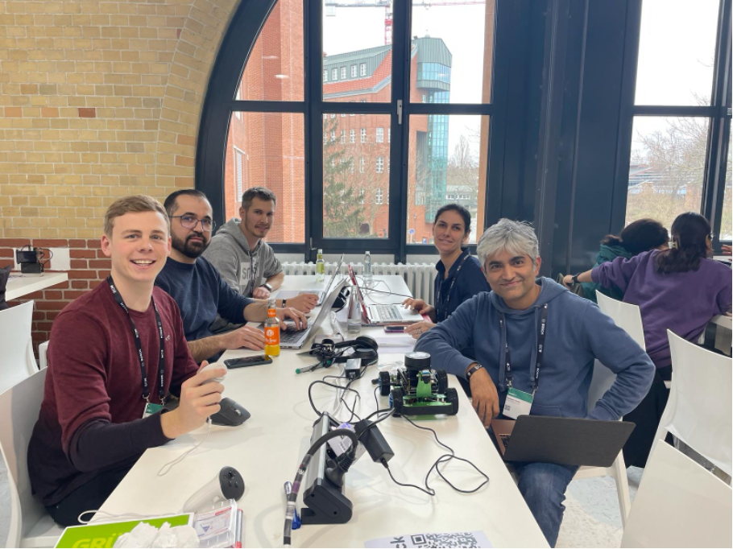
Happy Hacking Team

Slide 2
CARVIS - Why
Problem Space
Lack of trust in the vehicle to initiate the optimal transactions
Lack of experience of end user to estimate the value behind solutions

Slide 3
CARVIS - What
Solution
Establish a trusted identity for the transactions with vehicle as wallet (Wallet on Wheels)
Immersive & personalised experience to the end user in the virtual mobility world
Connect physical & virtual world

Slide 4
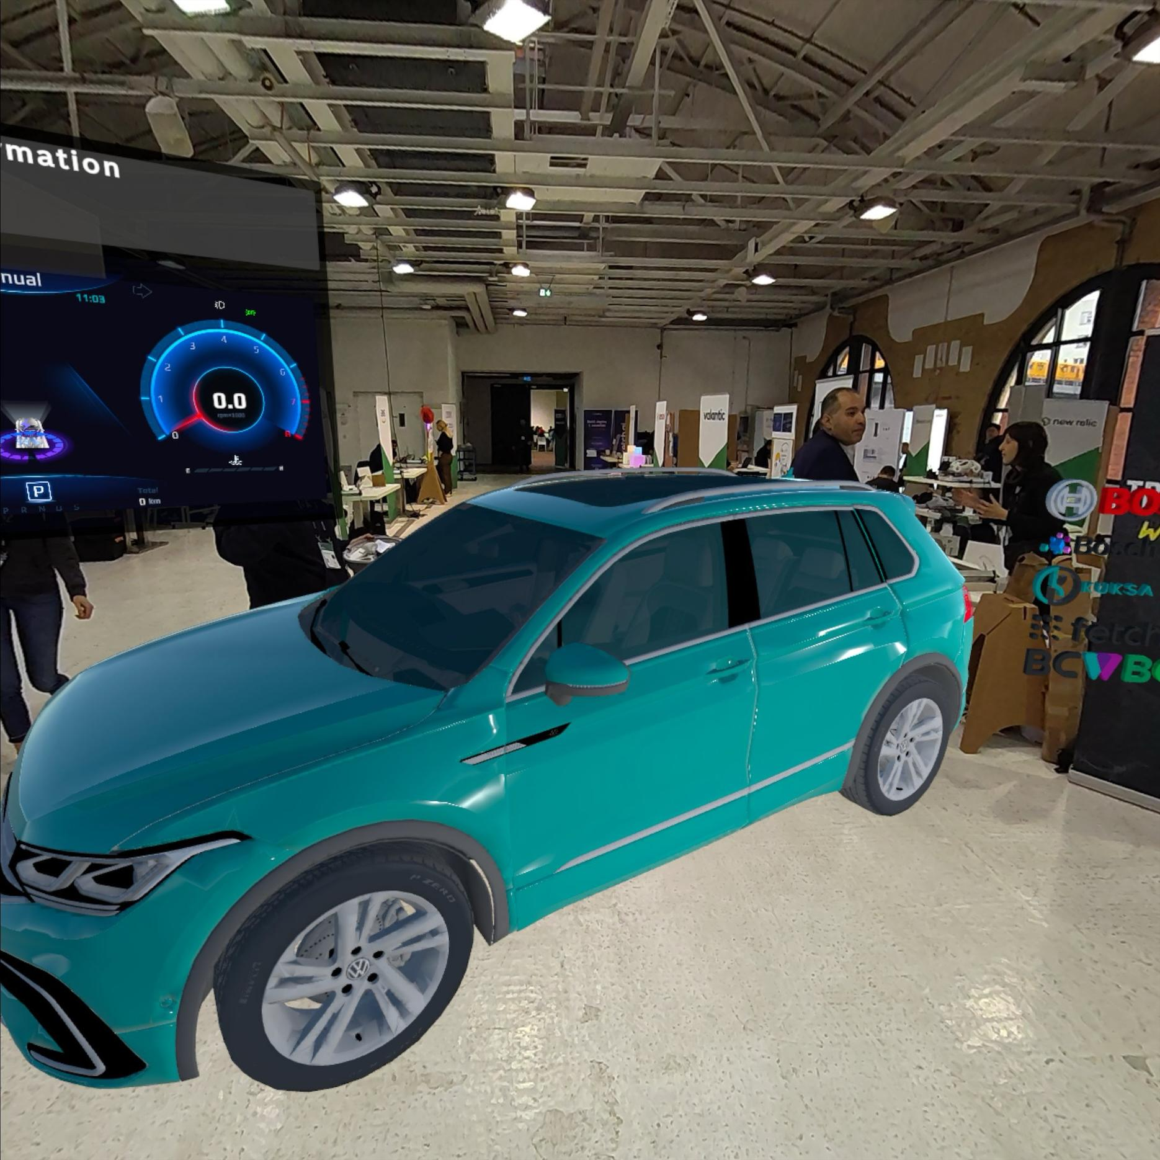
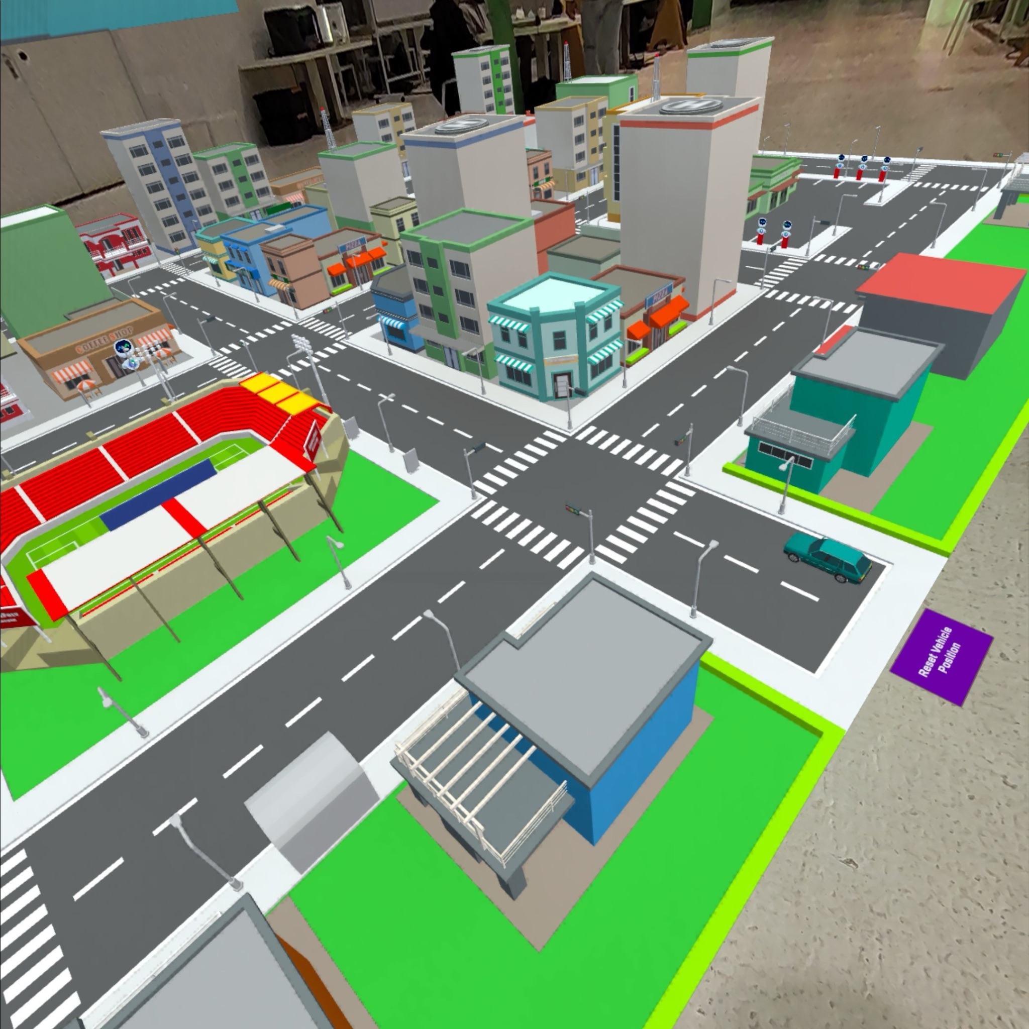
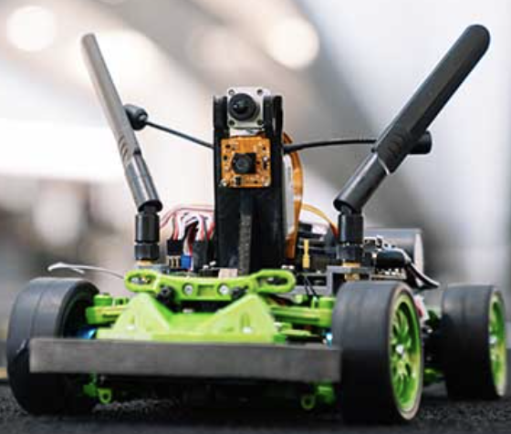
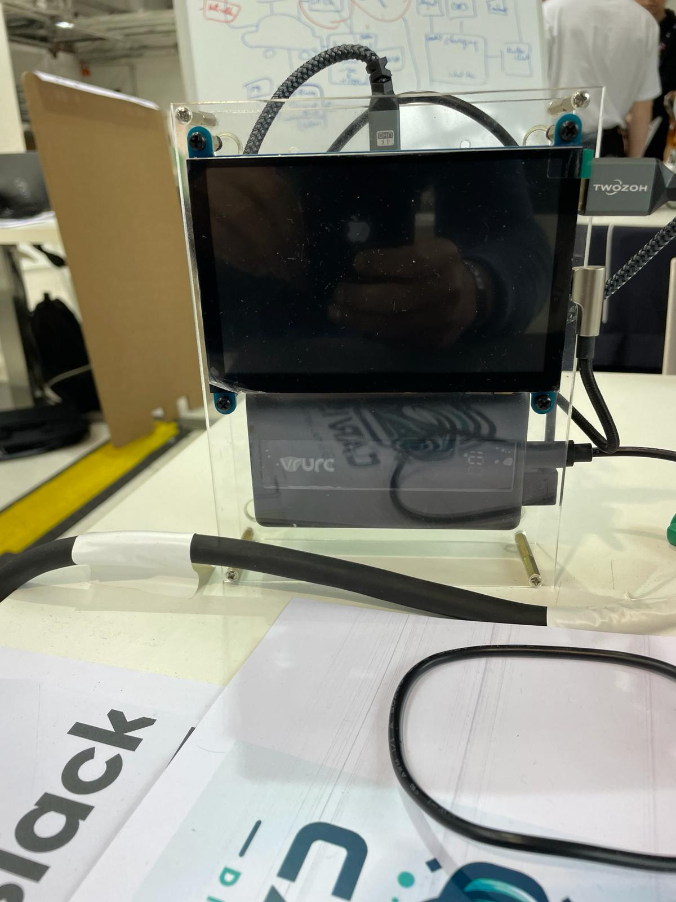
CARVIS - How
Immersive Charging Experience
Virtual world
Physical world

Slide 5
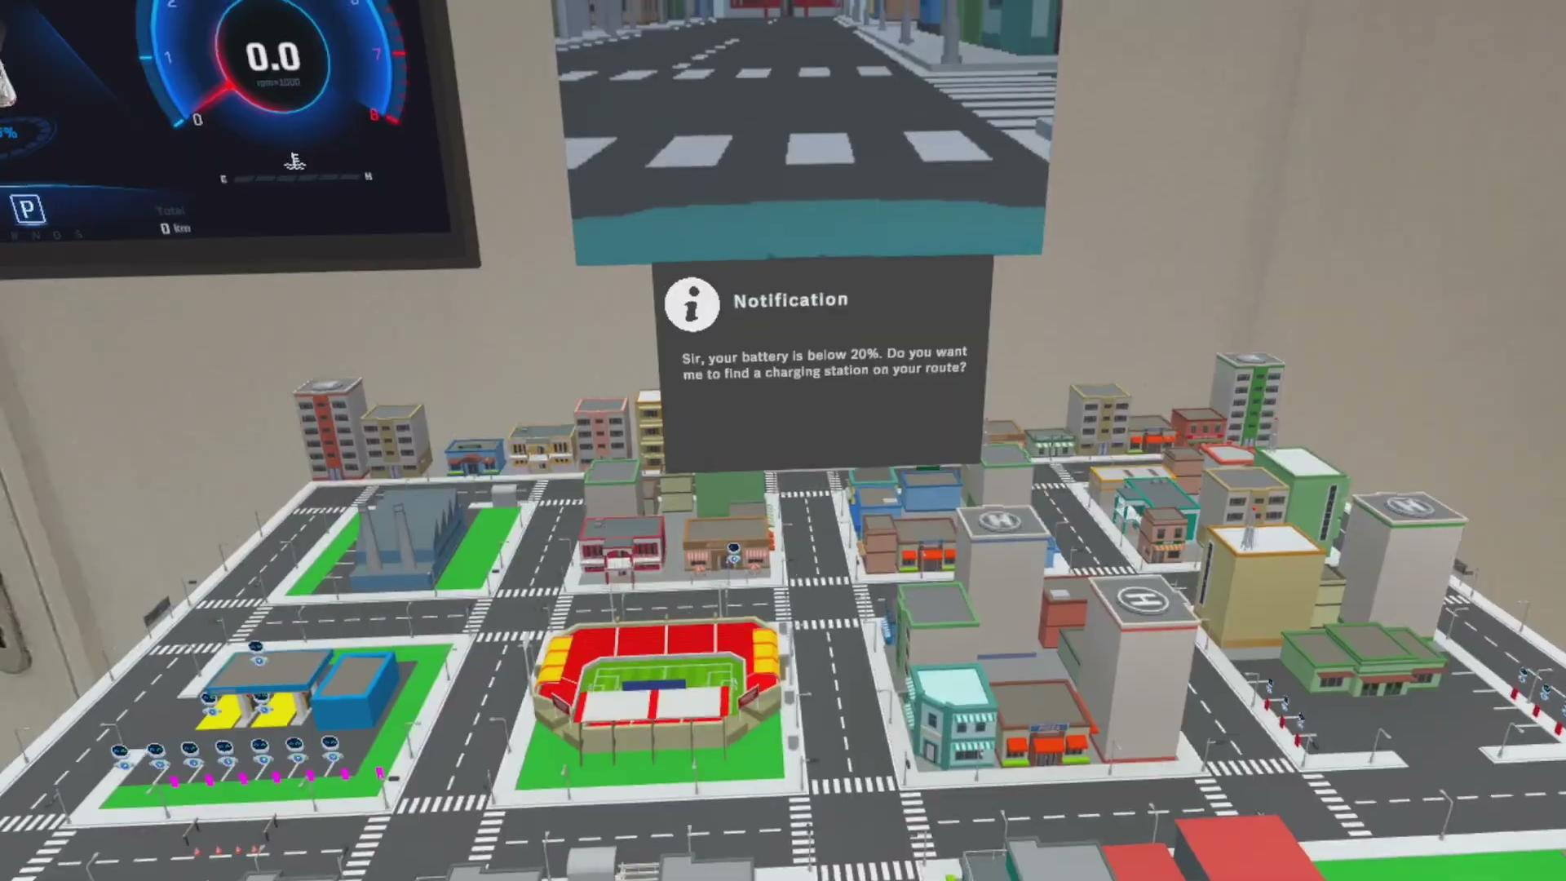
CARVIS - How
Immersive Charging Experience
Demonstration
Video

Slide 6
CARVIS - BUT
Money Money Money
Hardware manufacturer sell hardware to store Identity
Car manufacturers generate revenue with smart, trusted and compatible services that require Identity
Software providers develop software that utilizes Identity

Slide 7





Thanks to all our partners & coaches

Slide 8
Back up

Slide 9
Architecture
Virtual World
Virtual Vehicle
Personalisation
Agents
Charging Infra
Digital ID
Wallet
Data Broker
Self Sovereign identity
De-centralised Arch.
Physical World
Vehicle
Jet Racer
Charging Infrastructure
Raspberry PI
Data client
Agent
Wallet
Wallet

